Slide 1
Introduction to Data Analytics DSE-2151 B.tech Data Science & Engineering 3rd Semester Exploratory Analysis
Rohini R. Rao & Manjunath Hegde
Dept of Computer Applications
Sept 2021
(Slide set 2 out of 5)

Slide 2
Contents
Descriptive Statistics
Measures of Central Tendency
Visualization – Frequency Polygon
Visualization – Histogram or Bar chart
Measures of Dispersion
Visualization – Box Plot
Tables
Summary Tables
Contingency Tables
Multiple Tables
Bivariate Analysis – Scatter Plot
Comparative Statistics
Visualization
Inferential Statistics
Confidence Intervals
Hypothesis Testing
Chi-square
One-way analysis of variance
References

Slide 3
Population vs. Sample
Population:
A precise definition of all possible outcomes, measurements or values for which inferences will be made about.
Parameters are numbers that characterize a population
Sample:
A portion of the population that is representative of the entire population.
Statistics are numbers that summarize the data collected from a sample of the population
Sample must be an unbiased, random sample from the entire population.

Slide 4
Data sources include:
Surveys or polls – sampling & bias
Experiments - For example, when studying the effects of a new drug, a double blind study is usually used
Observational and other studies – when unethical to get experimental data
Operational database
Data warehouse or Historical data base
Purchased data base

Slide 5
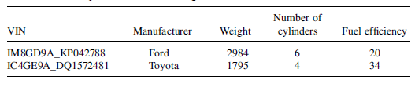
Data sets :
contain data objects which represents an entity
Data object is described by data fields called attributes
Attributes are also called as dimension, feature , variable
Values for a given attribute is observation
A set of attribute values are also called as attribute vector

Slide 6
Data types
Constant: A variable where every data value is the same.
Example - PI
Dichotomous or Binary: A variable where there are only two values
Example- Gender whose values can be male or female.
Discrete, Categoric or Nominal: A variable that can only take a certain number of values (either text or numbers).
Example- the variable Color where values could be black, blue, red etc.
Ordinal Scale – low, medium, high, grades – A+,A,B,C,D,E,F
Continuous or Numeric: A variable where an infinite number of numeric values are possible within a specific range.
Example- temperature between the minimum and maximum temperature, the variable could take any value

Slide 8
Descriptive Statistics Measuring Central Tendency
Arithmetic Mean
Let x₁,x₂,x₃….x_{n} be a set of N values or observations. The mean of this set of values is
(x₁ +x₂ + x₃….x_{n} ) / n
avg() function in SQL
Weighted Arithmetic Mean
(w_{1.}x₁ +w_{2.}x₂ + w_{3.}x₃….w_{n}x_{n} ) / n
The mean of grouped data is obtained from the same formula by replacing the weight w_{i} with frequency f_{i}
Weight represents importance, occurrence frequency or significance
Trimmed mean
remove top and bottom 2 %
All are algebraic measures
Advantages -it is easy to compute
Disadvantage- it is sensitive to outlier or extreme values.

Slide 9
Descriptive Statistics Measuring Central Tendency
Median
Sort the N numbers .
If N is odd the middle number is median ie. median is the element at (n+1)/2 th position
If N is even the average of middle two values is median ie. Median is the arithmetic mean or average of the element at n/2 th position and n/2+1 position
Median is a holistic measure
Advantages of Median
divides the sample such that 50 % of the items are below it
is not influenced by extreme observations
is better than mean for skewed data
Disadvantage
is computational complexity and nature of distribution must be known
Mode
for a set of data is the value that occurs most frequently in the set.
It is possible for the greatest frequency to correspond to several values which result in more than one mode – Multimodal
For unimodal frequency curves that are moderately skewed we have the following empirical relation
mean – mode = 3 * ( mean – median)
Advantages
is not influenced by outliers and it coincides with sample observation
Disadvantage
need not be unique

Slide 10
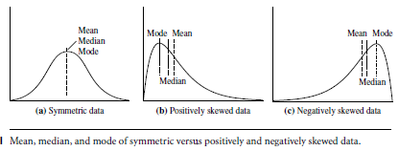
Descriptive Statistics Measuring Central Tendency
Midrange
is the average of the largest and smallest values in the set.
In algebraic terms can be calculated using max() or min()

Slide 12
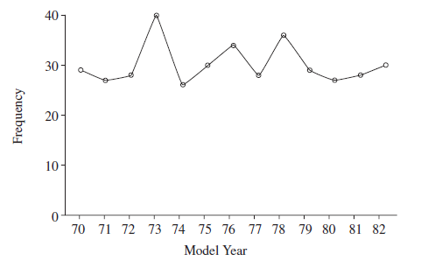
Descriptive Statistics Visualizing Central Tendency
Graphs enable us to visually identify trends, ranges, frequency distributions, relationships, outliers and make comparisons
Frequency Polygons
plot information according to the number of observations for each value (or ranges of values) for a particular variable

Slide 13
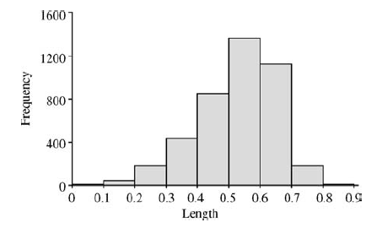
Descriptive Statistics Visualizing Central Tendency
Graphs enable us to visually identify trends, ranges, frequency distributions, relationships, outliers and make comparisons
Histogram
Useful for displaying the frequency distribution

Slide 14
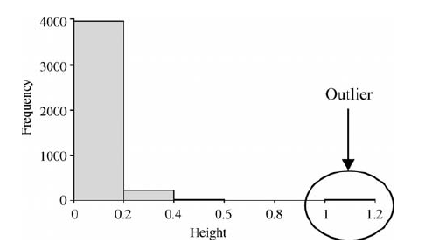
Descriptive Statistics Visualizing Central Tendency
Graphs enable us to visually identify trends, ranges, frequency distributions, relationships, outliers and make comparisons
Histogram
Useful for identifying outliers

Slide 16
Exploratory Analysis
How many persons have diabetes?
What is the average weight, average height?
Tabulate the gender attribute
What is the average , median, mode weight in males?
What is the average , median, mode weight in females?
Tabulate the BMI for Male vs Female.

Slide 17
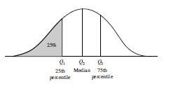
Descriptive Statistics Measuring Dispersion of Data
Degree to which numerical data tend to spread is called as dispersion or variance of data.
Common measures include
Range
five-number summary based on quartiles,
inter quartile range
standard deviation.

Slide 19

Descriptive Statistics Measuring Dispersion of Data
Range
Let x₁, x₂, … x_{n} be a set of observations for some attribute. The range of the set is the difference between the max() and the min() values.
Easy to compute but sensitive to outliers
Coefficient of Range = (Max – Min)/(Max + Min)
The kth percentile of a set of data in numerical order is the value xi having the property that k percent of the data lie at or below xi.
Median is 50th percentile.
Quartile ( Q₁) is 25th percentile. First Quartile is the value below which one-forth of the observations will fall
Quartile ( Q₃) is 75th percentile. Third quartile is the value below which three-forth of the observations will fall
Inter quartile range - The distance between the first and third quartile.
IQR = Q₃ – Q₁
Quartile Deviation is one half of IQR
IQR is unaffected by outliers and provides supplementary information of the spread of observations around the centre of the sample.
A common rule of thumb to identify suspected outliers is to single out values falling at least 1.5 * IQR above the third quartile or below the first quartile.
The five-number summary of a distribution consists of the
Minimum, Q₁, Median, Q₃ , Maximum.
Box plots are used to visualize them.

Slide 20
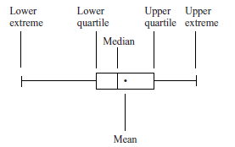
Descriptive Statistics Visualizing Dispersion of Data
Box Plot
provide a succinct summary of the overall distribution for a variable.
Five points are displayed:
the lower extreme value, the lower quartile, the median, the upper quartile, the upper extreme and the mean

Slide 21
Example 1
Calculate the quartile deviation from the following data
Roll No | 1 | 2 | 3 | 4 | 5 | 6 | 7 | 8 | 9 | 10 | 11 | 12
Mark | 39 | 40 | 40 | 41 | 41 | 42 | 42 | 43 | 43 | 44 | 44 | 45

Slide 22
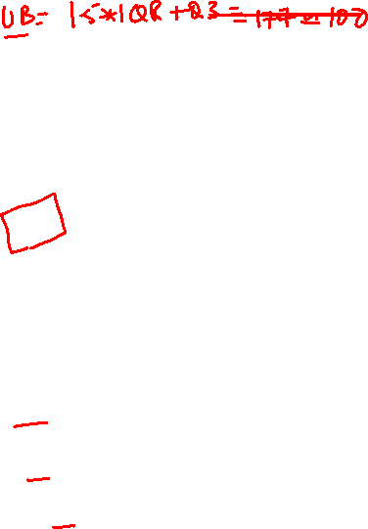
Example 2
Find 5 number summary
Compare the performance of Male vs Female
Roll No | 1 | 2 | 3 | 4 | 5 | 6 | 7 | 8 | 9 | 10 | 11 | 12
Mark | 23 | 25 | 73 | 65 | 43 | 65 | 89 | 35 | 58 | 100 | 77 | 87
Gender | M | F | M | M | F | F | F | M | F | M | F | M

Slide 23
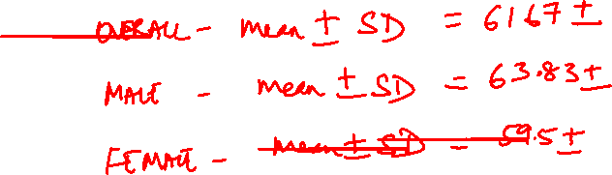
Example 2

Slide 24
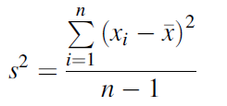
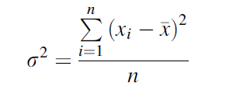
Descriptive Statistics Measuring Dispersion of Data
Variance
measure of the deviation of a variable from the mean.
The sample variance formula is
The population variance is defined as

Slide 25
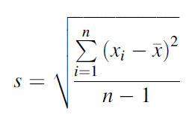
Descriptive Statistics Measuring Dispersion of Data
Standard Deviation
Also referred to as root mean square
If the frequency distribution is approximately normal, about 68% of all observations will fall within one standard deviation of the mean (34% less than and 34% greater than).
Approximately 95% of all observations fall within two standard deviations of the mean

Slide 26
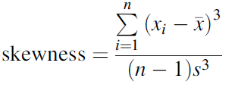
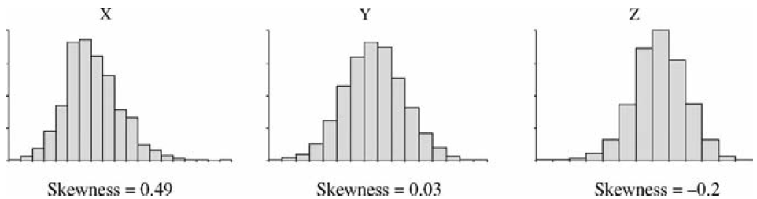
Descriptive Statistics Measuring Dispersion of Data
Skewness
Quantifies the lack of symmetry or skewness in the distribution

Slide 27
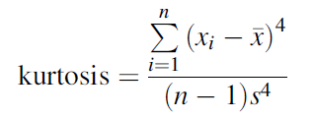
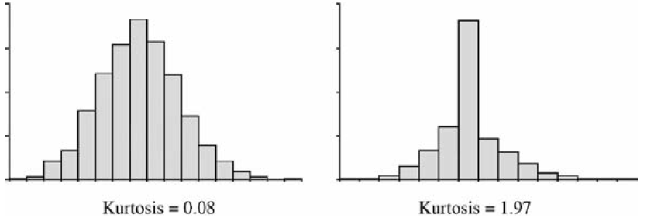
Descriptive Statistics Measuring Dispersion of Data
Kurtosis
Measures the peak of the distribution

Slide 28
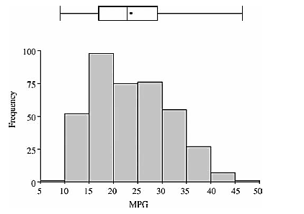
Descriptive Statistics Multiple Graphs

Slide 29
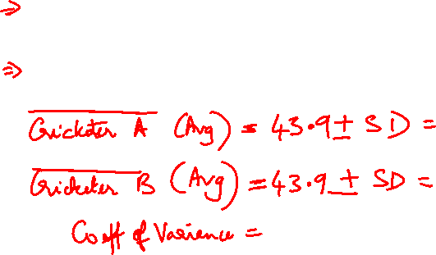
Example 3
The following are scores made by 2 cricketers in 10 innings. Compare the 2 players
Innings | 1 | 2 | 3 | 4 | 5 | 6 | 7 | 8 | 9 | 10
Cricketer A | 31 | 48 | 13 | 51 | 38 | 43 | 50 | 36 | 47 | 82
Cricketer B | 51 | 5 | 12 | 83 | 37 | 112 | 42 | 18 | 79 | 0

Slide 30
Case study 2: Breakfast Cereals Data Set
Abstract:
Adults should consume between 20 and 35 grams of dietary fiber per day.
The recommended daily intake for calories is 2200 for women and 2900 for men.
Calories come in three food components. There are 9 calories per gram of fat, and 4 calories per gram of carbohydrate and protein.
Overall, in your diet, no more than 10% of your calories should be consumed from simple carbohydrates (sugars), and no more than 30% should come from fat. The RDI of protein is 50 grams for women and 63 grams for men. The balance of calories should be consumed in the form of complex carbohydrates (starches).
The average adult with no defined risk factors or other dietary restrictions should consume between 1800 and 2400 mg of sodium per day.
The type and amount of milk added to cereal can make a significant difference in the fat and protein content of your breakfast.

Slide 31
Types of data analysis
What are the best cereals -gender wise?
Is there a link between calories & shelves?
Are the best rated cereals really healthy?
What ingredients best predict the amount of calories a cereal contains?
Does serving size play a role in the amount of calories?
An experiment or project idea
is to develop one's own rating system and find which cereal is the most healthy for an individual
To make cereal recommendations for individuals based on requirements

Slide 32
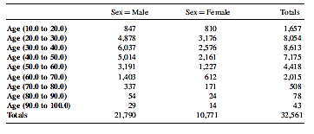
Descriptive Statistics Contingency tables
Also referred to as two-way cross tables
Provides insight into the relationship between two variables.
Variables must be categorical (dichotomous or discrete), or transformed to a categorical variable.

Slide 33
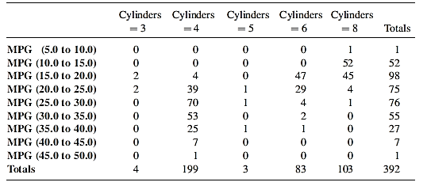
Descriptive Statistics Contingency table - (Miles per gallon vs. No. of Cylinders)

Slide 34
Descriptive Statistics Summary tables
A single categorical variable is used to group the observations.
Each row of the table represents a single group.
Descriptive statistics that summarize a set of observations can be used
statistics are commonly used:
Mean: The average value.
Median: The value at the mid-point.
Sum: The sum over all observations in the group.
Minimum: The minimum value.
Maximum: The maximum value.
Standard deviation: A standardized measure of the deviation of a variable from the mean.
Summary tables often show a count, number of observations (or percentage) that have that particular value (or range).

Slide 35
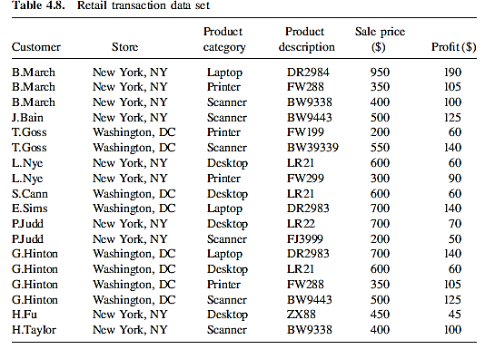
Example 1.

Slide 36
Example 1
Generate a contingency table summarizing the variables Store an
Generate the following summary tables:
a. Grouping by Customer and the showing a count of the number of observations and the sum of Sale price ($) for each row.
b. Grouping by Store and showing a count of the number of observations and the mean Sale price ($) for each row.
c. Grouping by Product category and showing a count of the number of observations and the sum of the Profit ($) for each row.
Create a histogram of Sales Price ($) using the following intervals: 0 to less than 250, 250 to less than 500, 500 to less than 750, 750 to less than 1000.
Create a scatterplot showing Sales price ($) against Profit ($).

Slide 37
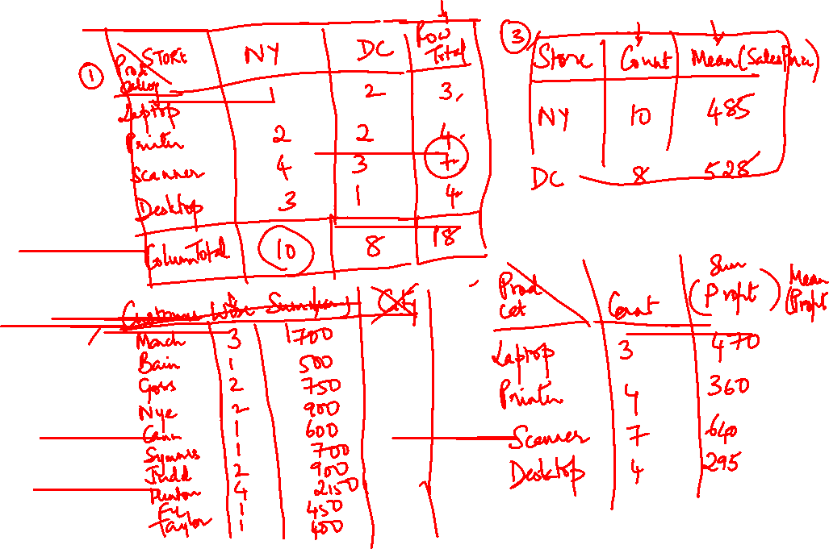

Slide 39
Example 2- Data Visualization
MS Excel – Northwind Dataset
What is the total sales/sales person in categories of products?
What is the total sales for each company in categories of products?
What are the top 10 selling items
Visualize the Customer’s region wise sales of items in each category
What is the sale of Boston Crab meat, customer wise?
Summarise % sales for each category of products yearwise
Report and analyse shipping country and category of products

Slide 40
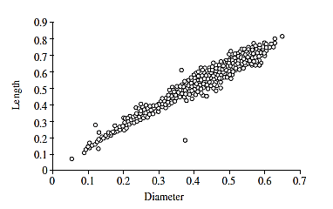
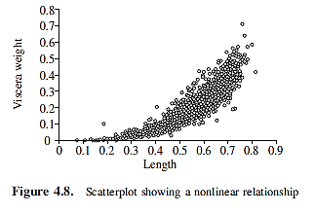
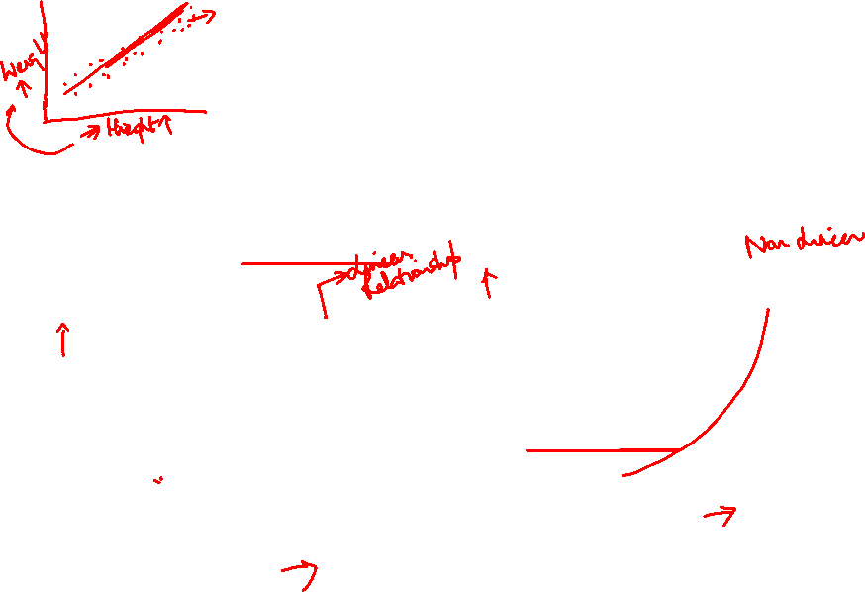
Descriptive Statistics Bivariate Analysis - Scatter Plots
To identify relationships between two continuous variables
Can be used to understand the type of relationships

Slide 41
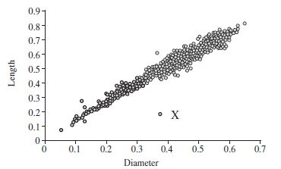
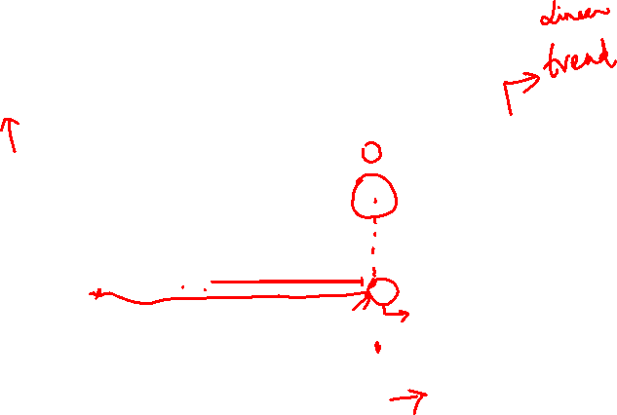
Descriptive Statistics Bivariate Analysis - Scatter Plots
To identify relationships between two continuous variables
Can be used to find outliers

Slide 42
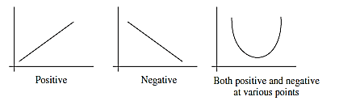
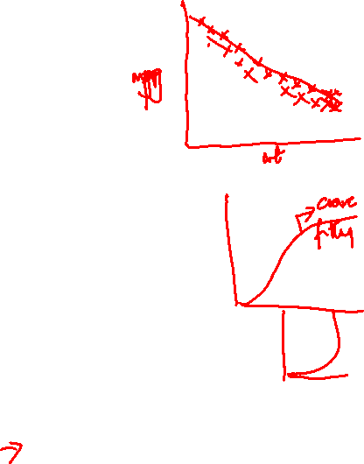
Comparative Analysis Correlation
Correlation analysis
looks at associations between variables.
existence of an association between variables does not imply that one variable causes another
Characteristics of the relationship can be measured:
Direction
Positive relationship
Negative relationship
Shape
Could be liner or nonlinear

Slide 43
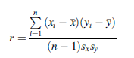

Comparative Analysis Correlation Coefficient for numeric variables
Generates values ranging from -1.0 to +1.0
The value of r reflects how close to straight line the points lie.
Positive numbers indicate a positive correlation
Negative numbers indicate a negative correlation.
If r is around 0 then there appears to be little or no relationship between the variables

Slide 44
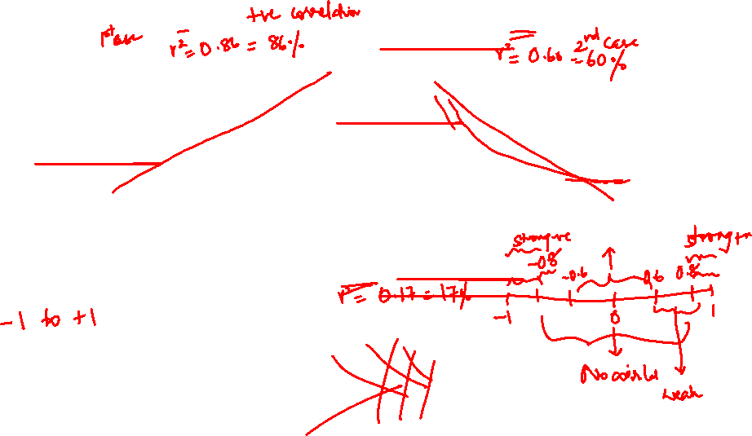

Slide 45
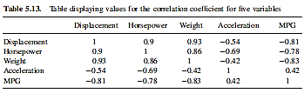
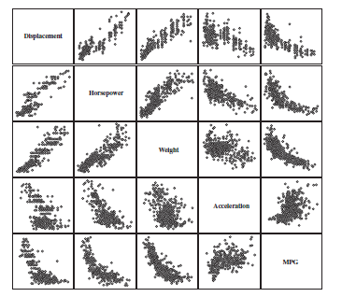

Correlation Analysis for more than two numeric variables

Slide 46
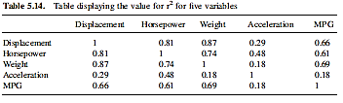

Correlation Analysis for more than two numeric variables
Correlation Coefficient is squared to indicate percentage of variation that is explained by the regression line
The coefficient of determination represents the percent of the data that is the closest to the line of best fit.

Slide 47
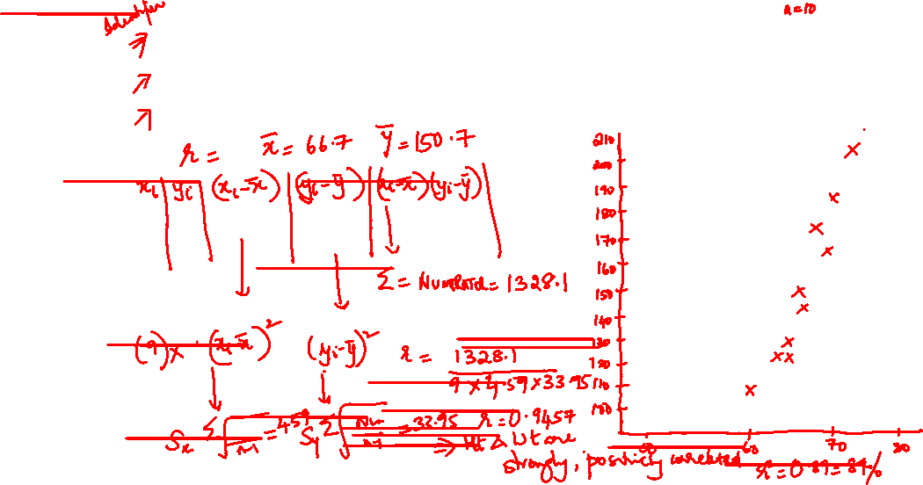
Example 1 –Pearsons Correlation
Roll no | 1 | 2 | 3 | 4 | 5 | 6 | 7 | 8 | 9 | 10
Weight | 60 | 62 | 63 | 64 | 65 | 68 | 69 | 70 | 72 | 74
Height | 102 | 120 | 130 | 150 | 120 | 145 | 175 | 170 | 185 | 210

Slide 48
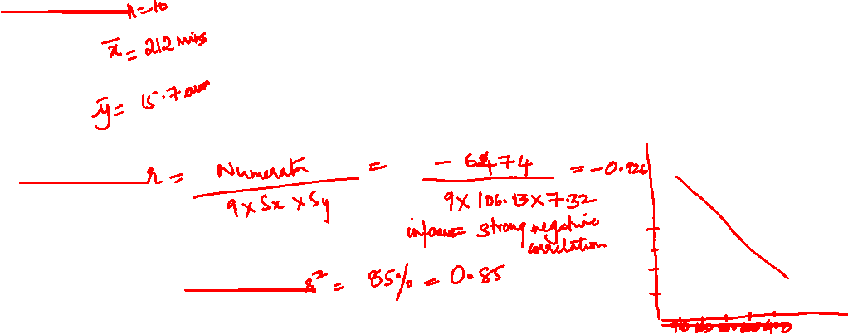
Example 2 – Pearsons Correlation
Errors in test and study time
n | 1 | 2 | 3 | 4 | 5 | 6 | 7 | 8 | 9 | 10
Study time (in mins) | 90 | 100 | 130 | 150 | 180 | 200 | 220 | 300 | 350 | 400
No of errors | 25 | 28 | 20 | 20 | 15 | 12 | 13 | 10 | 8 | 6

Slide 49

Case Study: Correlation between birth month & health
Columbia University scientists found 55 diseases that correlated with the season of birth.
compares 1,688 diseases against the birth dates and medical histories of 1.7 million patients treated at NewYork-Presbyterian Hospital/CUMC between 1985 and 2013.
The study proved more than 1,600 associations and confirmed 39 links previously reported in the medical literature.
The researchers performed statistical tests to check that the 55 diseases for which they found associations did not arise by chance.
The risk related to birth month is relatively minor when compared to more influential variables like diet and exercise.”
For example
the study found that asthma risk is greatest for July and October babies. Danish study on the disease found that the peak risk was in the months (May and August).
For ADHD, around one in 675 occurrences could relate to being born in New York in November. This result matches a Swedish study showing peak rates of ADHD in November babies.
The researchers also found a relationship between birth month and nine types of heart disease, with people born in March facing the highest risk for atrial fibrillation, congestive heart failure, and mitral valve disorder. Austrian and Danish patient records found that those born in months with higher heart disease rates—March through June—had shorter life spans.
Overall, the study indicated people born in May had the lowest disease risk, and those born in October the highest. This data could help scientists uncover new disease risk factors

Slide 50
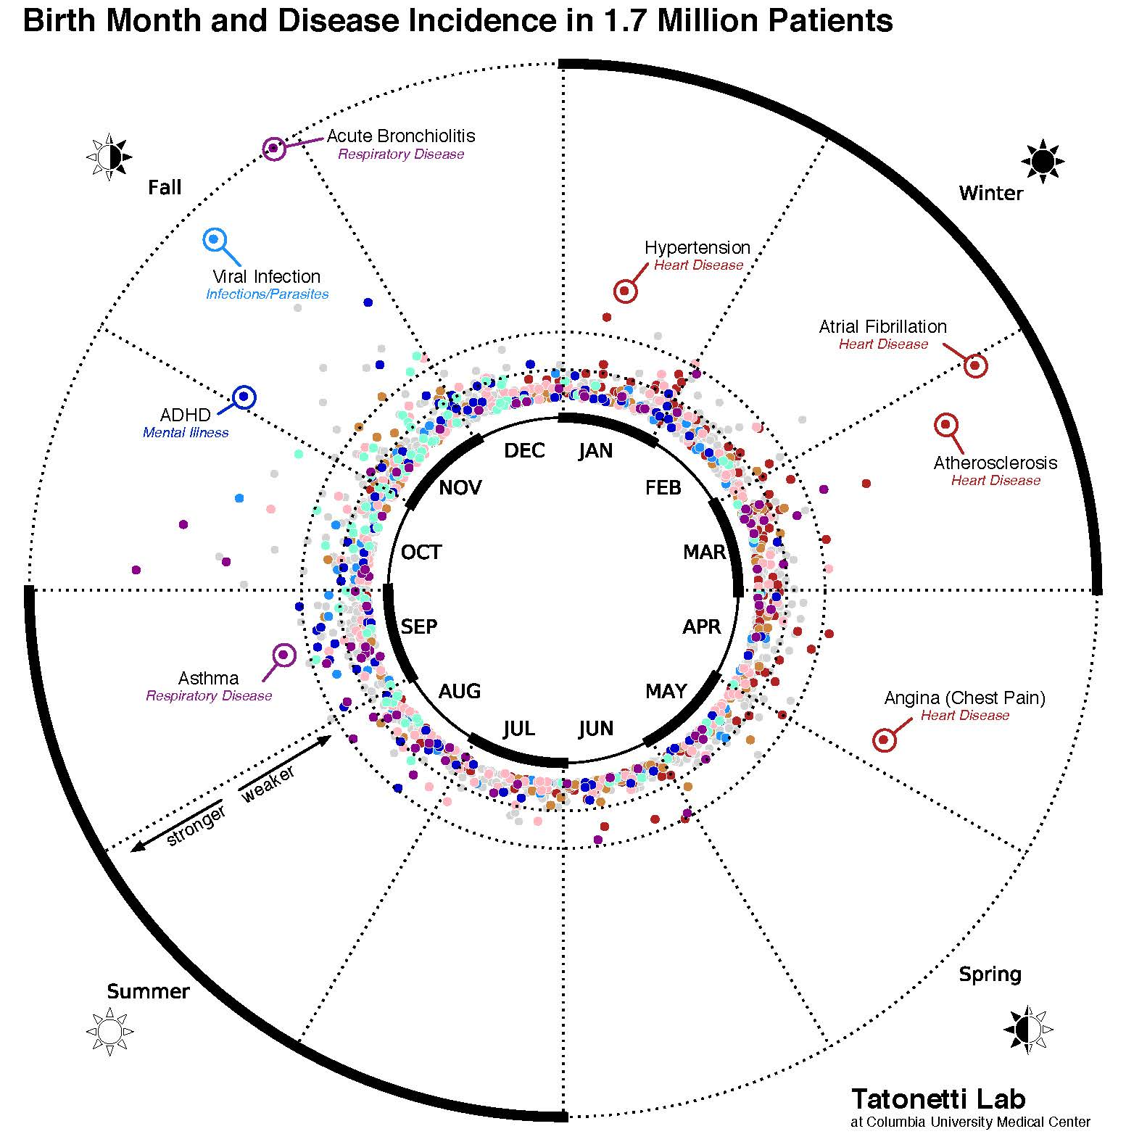


Slide 51
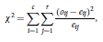
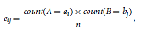
Comparative Analysis for discrete variables
Chi-square test
is a hypothesis test for nominal variables
tests the hypothesis that A and B are independent, that is, there is no correlation between them
Hypothesis includes
Null hypothesis H₀: There is no relationship or they are independent
Alternate hypothesis H_{a}: There is a relationship or dependence
A contingency table or pivot table is constructed for variables
The chi-square test
Where expected frequency is
The test is based on a significance level with (r-1) * (c-1) degrees of freedom

Slide 52
Example 1
Are gender and preferred reading correlated?
 | Male | Female | Total
Fiction | 250 | 200 | 450
Non Fiction | 50 | 1000 | 1050
Total | 300 | 1200

Slide 53
Example 1
Are gender and preferred reading correlated?
 | Male | Female | Total
Fiction | 250 | 200 | 450
Non Fiction | 50 | 1000 | 1050
Total | 300 | 1200

Slide 54
Example 2
 | Male | Female | Totals
Supervisor | 20 | 15 | 35
Shelf Stacker | 20 | 30 | 50
Till Operator | 10 | 35 | 45
Cleaner | 10 | 40 | 50
 | 60 | 120 | 180

Slide 55
Example 2
 | Male | Female | Totals
Supervisor | 20 | 15 | 35
Shelf Stacker | 20 | 30 | 50
Till Operator | 10 | 35 | 45
Cleaner | 10 | 40 | 50
 | 60 | 120 | 180

Slide 56
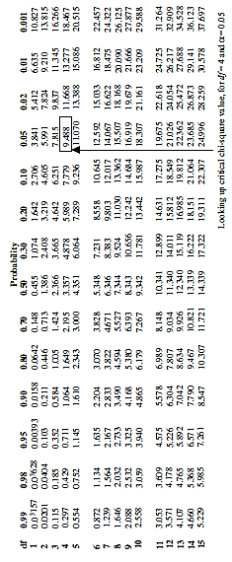
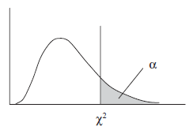
Comparative Analysis for discrete variables
Chi-square table –
Indicates distribution of sampling SD.
skewed distribution with degrees of freedom

Slide 57
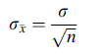
Inferential Analysis Overview
Sampling error
If the process of selecting a random sample was repeated a number of times, the means from each sample would be different
Sampling distribution
the distribution of the mean values follows a normal distribution for sample sizes greater than 30
The sampling distribution is normally distributed because of the central limit theorem
Standard error
Relationship between the variance of the original variable and the number of observations in the sample to the sampling distribution is represented as
Where n is sample size and σ is std deviation of population “s”

Slide 58
Sampling Distribution of mean

Slide 59
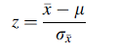
Inferential Analysis Overview
Inferential statistics
chance or probability that we will see a particular range of average values
Sampling distribution to make this assessment of probabilities.
From the central limit theorem , when n >=30 , for any population distribution, the sampling distribution of x̄, is approximately normally distributed with mean µ and standard deviation σ/√n where µ and σ are population values
The total area under the normal distribution curve is 1
The area between specific z-score ranges represents the probability that a value would lie within this range

Slide 60
Inferential Analysis Overview
Standard Error Calculation methods
Confidence intervals:
A confidence interval allows us to make statements concerning the likely range that a population parameter (such as the mean) lies within.
Hypothesis tests:
A hypothesis test determines whether the data collected supports a specific claim.
A hypothesis test can refer to
a single group
refer to two groups
Chi-square:
The chi-square test is a statistical test procedure to understand whether a relationship exists between pairs of categorical variables.
One-way analysis of variance:
This test determines whether a relationship exists between three or more group means.

Slide 62
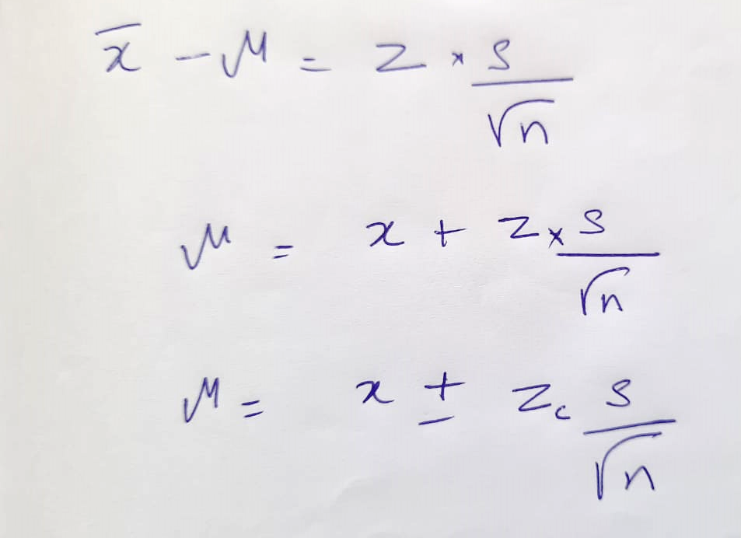
Confidence Intervals Formula

Slide 63
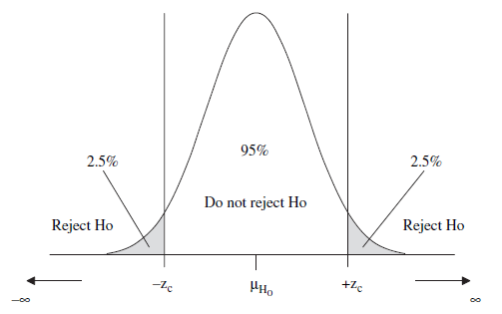
Confidence Levels -

Slide 64
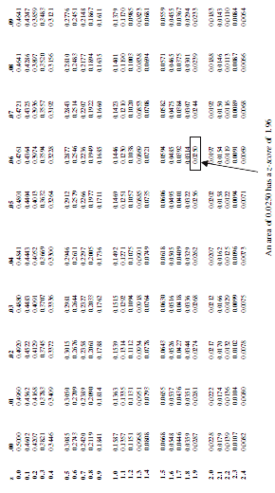
Determining critical z-score from normal distribution table

Slide 65
Common z-score values
Confidence Level | Area between 0 and z-score | Area in one tail (alpha/2) | z-score
50% | 0.2500 | 0.2500 | 0.674
80% | 0.4000 | 0.1000 | 1.282
90% | 0.4500 | 0.0500 | 1.645
95% | 0.4750 | 0.0250 | 1.960
98% | 0.4900 | 0.0100 | 2.326
99% | 0.4950 | 0.0050 | 2.576

Slide 66
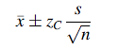
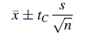
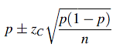
Inferential Analysis Standard Error Calculation methods
Confidence intervals:
Range of values could be used as an estimate for a population
Commonly used confidence levels are 90%, 95% & 99%
Confidence Ranges for Continuous Variables
Confidence levels
for large samples where z-score is number of standard deviations for a given confidence level , n >= 30
For small samples
Confidence Range for Categorical Variables

Slide 67
Problem 1 : Confidence Intervals
Calculate a confidence interval for a set of 54 observations with a mean value of 33.25 and a standard deviation of 12.26. Let the confidence level be 95%

Slide 68
For n < 30 use t distribution
Has fatter tails than the normal distribution
Distribution will result in larger confidence intervals for smaller samples
T- distribution based on degrees of freedom , which is 1 minus the sample size

Slide 69
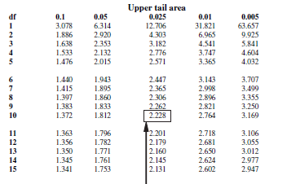
Determining critical t value based on df

Slide 70
Problem 2: Confidence Intervals –small samples
a set of 11 (n) observations was recorded and the mean value was calculated at 23.22 (x), with a standard deviation of 11.98 (s).

Slide 71
Problem 3: Confidence Intervals – Categorical Variables
A factory is interested in the proportion of units produced with errors. To make this assessment, a sample of 300 units are tested for errors, and it is determined that 45 contain a problem. Compute the Confidence Interval for the population.

Slide 72

Inferential Analysis Standard Error Calculation methods
One-way analysis of variance (ANOVA)
compares the means from three or more different groups
Can be applied to
cases where the groups are independent and random
the distributions are normal
the populations have similar variances.
hypothesis statement:
H₀: The sample means are equal
H_{a}: The sample means are not equal
The test has the following steps:
1. Calculate group means and standard deviations
2. Determine the within group variation
(Mean Square Within)

Slide 73



Inferential Analysis Standard Error Calculation methods
One-way analysis of variance
The test has the following steps:
3. Determine the between group variation
(Mean Square Between)
4. Determine the F-statistic, using the within and between group variation
5. Test the significance of the F-statistic

Slide 74
Problem 4
For example, an on-line computer retail company has call centers in four different locations. These call centers are approximately the same size and handle a certain number of calls each day. An analysis of the different call centers based on the average number of calls processed each day is required.
H₀: The sample means are equal
H_{a}: The sample means are not equal

Slide 75
Problem 4:

Slide 76
Problem 4
Call Centre
A B C D

Slide 77
Problem 4
Critical Value for F-Statistic is 2.99

Slide 78

Critical f-statistic

Slide 79
Inferential Analysis Standard Error Calculation methods
Hypothesis Testing
Null hypothesis (H_{o}0):
Claim that a particular population parameter (e.g. mean) equals a specific value.
Alternative hypothesis (H_{a}a):
Conclusion that we would be interested in reaching if the null hypothesis is rejected.
Also called research hypothesis
Hypothesis Assessment
The statistic of interest from the sample is calculated
difference between the value claimed in the hypothesis statement and the calculated sample statistic.
Approach 1 – α – significance level of test
For large sample sets - identifying where the hypothesis test result is located on the normal distribution curve of the sampling distribution, will determine whether the null hypothesis is rejected.
Approach 2 – statistic looked up a Normal Distribution table to find p-value.
If hypothesis test is two-sided double p-value & compare with α
If p-value is lesser than α then null hypothesis is rejected

Slide 80


Inferential Analysis Standard Error Calculation methods
Hypothesis Test: Single Group, Continuous Data
Hypothesis Test: Single Group, Categorical Data

Slide 81

Inferential Analysis Standard Error Calculation methods
Hypothesis Testing – two tailed test
Ha: µ ≠ 0

Slide 82
Problem 5
To test the hypothesis that the number of days to process a passport is 12 (m), 45 passport applications were randomly selected and timed . The average time to process the passport application was 12.1 (x) and the standard deviation was 0.23 (s) and confidence level was set to 95%.
Z-score of 2.9 > 1.96
we reject the null hypothesis
the average number of days to process a passport is not 12 days.

Slide 83
Problem 6
To test the claim that more than eight out of ten dog owners prefer a certain brand (brand X) of dog food
Claim :
To test this hypothesis, 40 random dog owners (n = 40) were questioned and the proportion that responded that they preferred brand X was 33 out of 40 .
Z = 0.395
Z_{c} = 1.65
we do not reject the null hypothesis.

Slide 84

Inferential Analysis Standard Error Calculation methods
Hypothesis Testing – one tailed test

Slide 85
Determining critical z-score from normal distribution table

Slide 86



Inferential Analysis Standard Error Calculation methods
Hypothesis Test: Two Groups, Continuous Data
When group size is less than 30
When group size is greater than 30
Hypothesis Test: Two Groups, Categorical Data

Slide 87
Problem 7
Claim: A new drug reduces the number of strokes.
where p1 is the proportion of the population with strokes taking the new medicine
and p2 is the proportion of the population with strokes taking the placebo.

Slide 88
Problem 7
There were 10,004 patients in the first group who took the medicine (n1). and of these 213 had strokes (X1). There were 10,013 patients in group 2 that did not take the medicine and took a placebo instead (n2) and in this group 342 patients had a stroke (X2).

Slide 89
Problem 7
Z = -5.5
we reject the null hypothesis
Conclude the number of strokes for the group taking the
medicine is lower than the group that does not take the medicine.

Slide 90

Inferential Analysis Standard Error Calculation methods
Paired Test
Claim: There is no difference in the wear of shoes made from material X compared to shoes made from material Y.
To test this claim, the null and alternative hypothesis are set up:
H_{o}o: µ_{D}= 0
H_{a}o: µ_{D} ≠0
where µ D is the difference between the wear of shoes made with material X and the wear of shoes made with material Y.
Formula used

Slide 91
Errors
hypothesis test is based on a sample and samples vary
potential errors are:
Type I Error: null hypothesis is rejected when it really should not be. These errors are minimized by setting the value of alpha low.
Type II Error: null hypothesis is not rejected when it should have been. These errors are minimized by increasing the number of observations in the sample.

Slide 92


Slide 93
References
Glenn J. Myatt, Making Sense of Data: A Practical Guide to Exploratory Data Analysis and Data Mining, John Wiley, November 2006.
G. Shmueli, N. R. Patel, and P.C. Bruce, Data Mining for Business Intelligence, John Wiley and Sons, 2010

